Slide 1
CSE 228 – Principles of Artificial Intelligence
Module #3, Lecture #5

Slide 2
More Problems to Solve

Slide 3
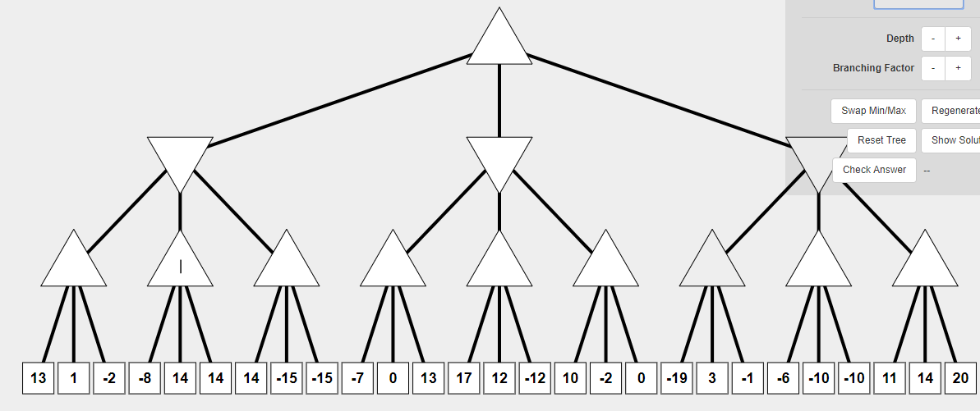
SOLVE…

Slide 4
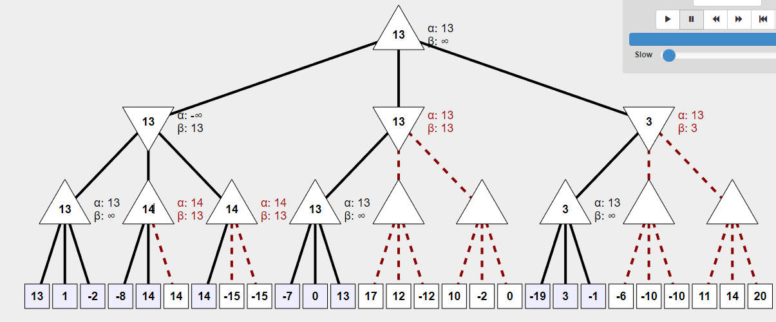

Slide 5
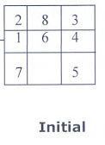
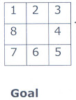

Solve using DFS

Slide 6
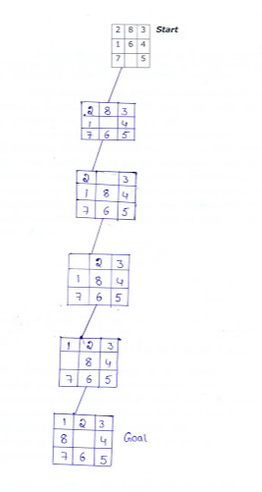

Slide 7
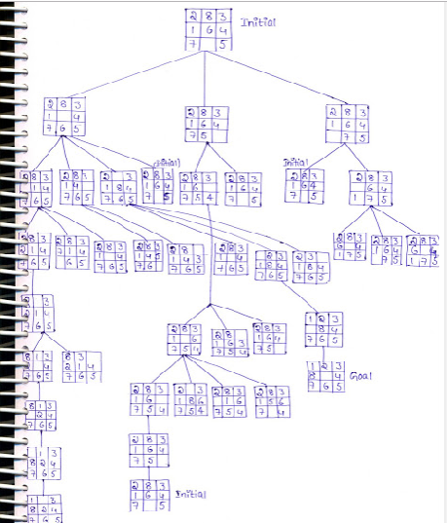

Slide 8
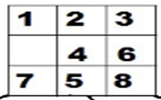
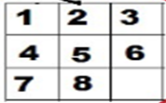
Solve using A*
Initial State
GOAL State
Heuristic ?
f-score = h-score + g-score
h-score : Number of misplaced tiles by comparing the current state and the goal state (summation of the Manhattan distance between misplaced nodes)
g-score : Number of nodes traversed from start node to get to the current node.

Slide 9
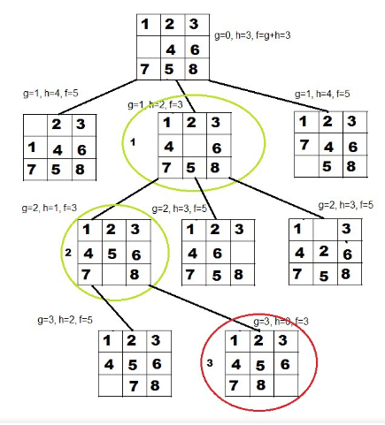

Slide 10
Solve using A*
Initial State
GOAL State
Heuristic ?
H Score / M - Score
Hamming priority function: The number of blocks in the wrong position, plus the number of moves made so far to get to the state. (A state with a small number of blocks in the wrong position is close to the goal state, and we prefer a state that have been reached using a small number of moves.)
Manhattan priority function: The sum of the distances (sum of the vertical and horizontal distance) from the blocks to their goal positions, plus the number of moves made so far to get to the state.

Slide 11
Constraint Network
Constraint Network is a graph where:
1 node / vertex for every variable (represented as a circle)
1 node / edge for every constraint (represented as a rectangle)
Undirected edges between variable and constraint nodes when a variable is involved in a constraint.
Example: 2 variables X, and Y, where X < Y.
X
X < Y
Y

Slide 12
Arc Consistency of Constraint Network
An arc <x, R(x,y)> is arc consistent if, for each value of x in Domain(X), there is some value Y in Domain(Y) where R(x,y) is satisfied.
A network is arc consistent if all its arcs are consistent.

Slide 13
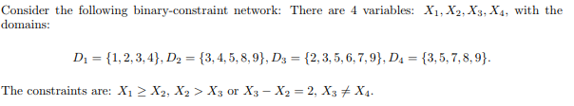
Is the network arc-consistent ? If not, compute the arc-consistent network.

Slide 14
Relational Form
Relation | Domain
X1 >= X2 | (3,3), (4,3), (4,4)
X2 > X3 or X3 – X2 = 2 | (3,2), (4,2), (4,3), (5,2), (5,3), (8,2), (8,3), (8,5), (8,6), (8,7), (9,2), (9,3), (9,5), (9,6), (9,7), (3,5), (4,6), (5,7)
X3 != X4 | (2,3), (2,5), (2,7), (2,8), (2,9), (3,5), (3,7), (3,8), (3,9), (5,3), (5,7), (5,8), (5,9), (6,3), (6,5) (6,7), (6,8), (6,9), (7,3), (7,5), (7,8), (7,9), (9,3), (9,5), (9,7), (9,8)

Slide 15
Constraint Graph
X1={1,2,3,4}
X1 >= X2
X2={3,4,5,8,9}
X2 > X3 or X2 = X3-2
X3={2,3,5,6,7,9}
X4={3,5,7,8,9}
X3 != X4

Slide 16
Arc Constraint Graph
X1={3,4}
X1 >= X2
X2={3,4}
X2 > X3 or X2 = X3-2
X3={2,3,5,6}
X4={3,5,7,8,9}
X3 != X4

Slide 17
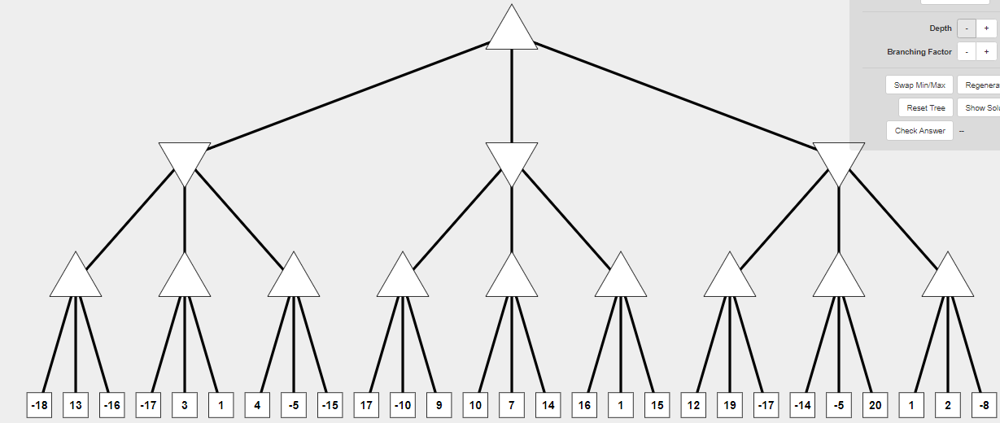
Solve using Alpha Beta Pruning

Slide 18
